Slide 1
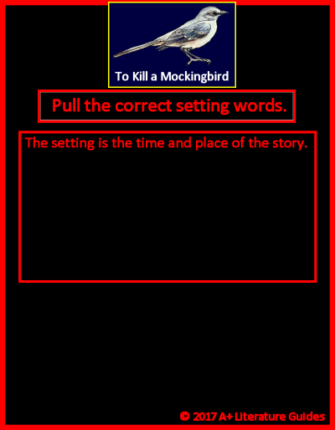









Drag and drop (into the center area) the words that correctly identify the novel’s setting.

Slide 2
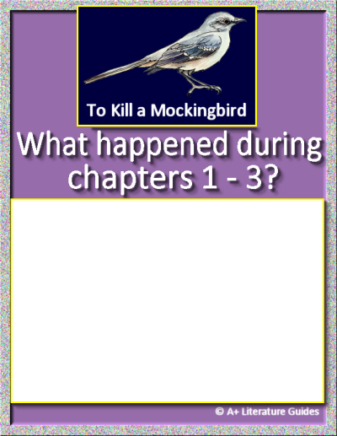
For each chapter, record:
Chapter’s setting
Main events
One of the following:
Character actions, relationships, traits
Internal/external conflicts/challenges, solutions/resolutions
Themes, messages
Questions, predictions
Mood, tone
Chapter 1
Insert text
Insert text
Insert text
Insert text
Chapter 2
Insert text
Insert text
Insert text
Insert text
Chapter 3
Insert text
Insert text
Insert text
Insert text
Insert text

Slide 3
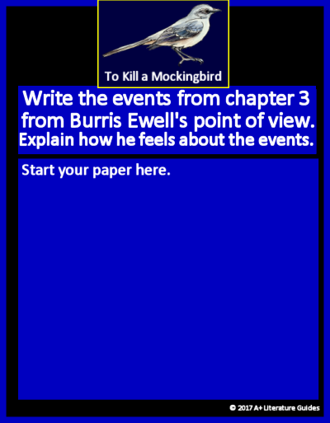
Discuss at least three of the following (and then discuss how Burris likely feels).
His appearance
His hygiene
The language he uses toward the teacher
His classmates’ reactions toward Burris or Miss Caroline
His departure from the classroom
From Burris Ewell’s point of view, here is a reimagining of the events of Chapter 3:
Insert text
Insert text
Insert text
As a result, Burris likely feels:
Insert text

Slide 4
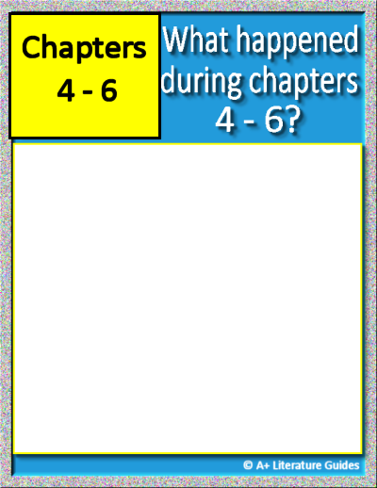
Chapter 4
Insert text
Insert text
Insert text
Insert text
Insert text
Chapter 5
Insert text
Insert text
Insert text
Insert text
Insert text
Chapter 6
Insert text
Insert text
Insert text
Insert text
Insert text
For each chapter, record:
Chapter’s setting
Main events
One of the following:
Character actions, relationships, traits
Internal/external conflicts/challenges, solutions/resolutions
Themes, messages
Questions, predictions
Mood, tone

Slide 5

Character Trait Word Bank
Absent-minded
Aggressive
Ambitious
Boastful
Bold
Bossy
Brave
Calm
Careful
Caring
Compassionate
Compliant
Creative
Cruel
Curious
Determined
Distrustful
Dreamy
Empathetic
Energetic
Fair
Focused
Friendly
Hardworking
Helpful
Honest
Humble
Imaginative
Independent
Jealous
Kind
Lazy
Loud
Loyal
Mature
Mean
Mysterious
Nosy
Nurturing
Observant
Overconfident
Patient
Persistent
Polite
Principled
Protective
Pushy
Quiet
Reckless
Reflective
Reserved
Resilient
Responsible
Rude
Selfish
Serious
Shy
Simple
Smart
Sneaky
Stubborn
Thoughtful
Thoughtless
Trustworthy
Understanding
Watchful
Withdrawn
Insert text
Insert text
Insert text
Insert text
Insert text
Insert text
Insert text
Insert text
Insert text
Insert text

Slide 6
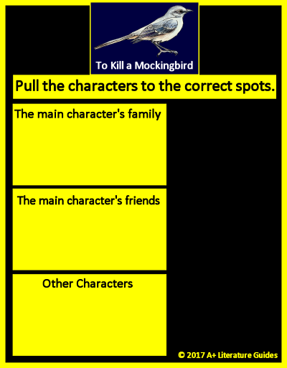










Drag and drop each character into the correct area.

Slide 7

Chapters 1-6

